Slide 1
Running a Pyspark cluster on a server
This tutorial will show you how to set-up a server cluster with Apache Spark, how to load data into it, and interact with your cluster using a Jupyter Notebook PySpark interface

Slide 2
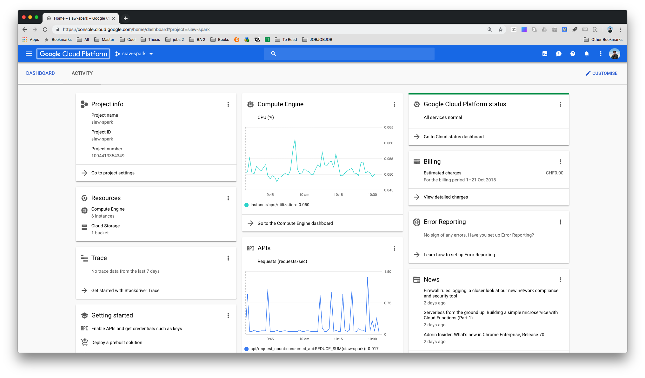
Step1: OPen Google cloud platform
If you already have an account simply log-in
If you do not have a Google Cloud Platform (GCP) account go to https://cloud.google.com/ and create a free account
If this is your first account, you will receive 300 USD of free platform credit so you should not be incurring any costs for the sake of this tutorial
As soon as you have your account set up create a new project. The name used for this example will be called “siaw-spark”
You should now be able to see your dashboard

Slide 3
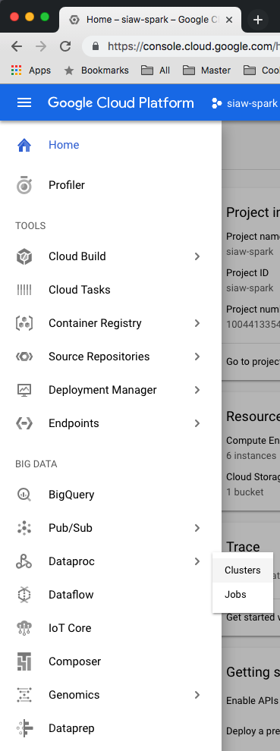
2. Cluster Creation
Go to the menu in the top left corner and look for the item “Dataproc” under the subcategory “Big Data”
Click on “Clusters”

Slide 4
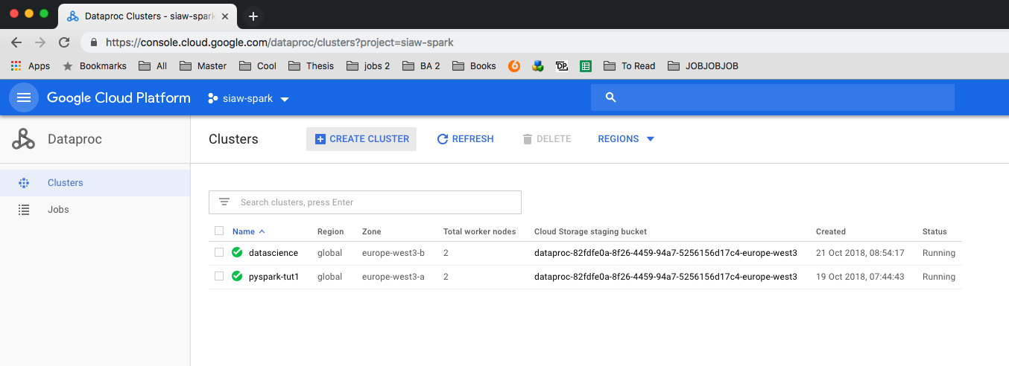
2. Cluster Creation
In the new menu you will see no clusters running so far.
If prompted, first enable the Cloud Dataproc API by following the instructions provided
Next, click on “create cluster”

Slide 5
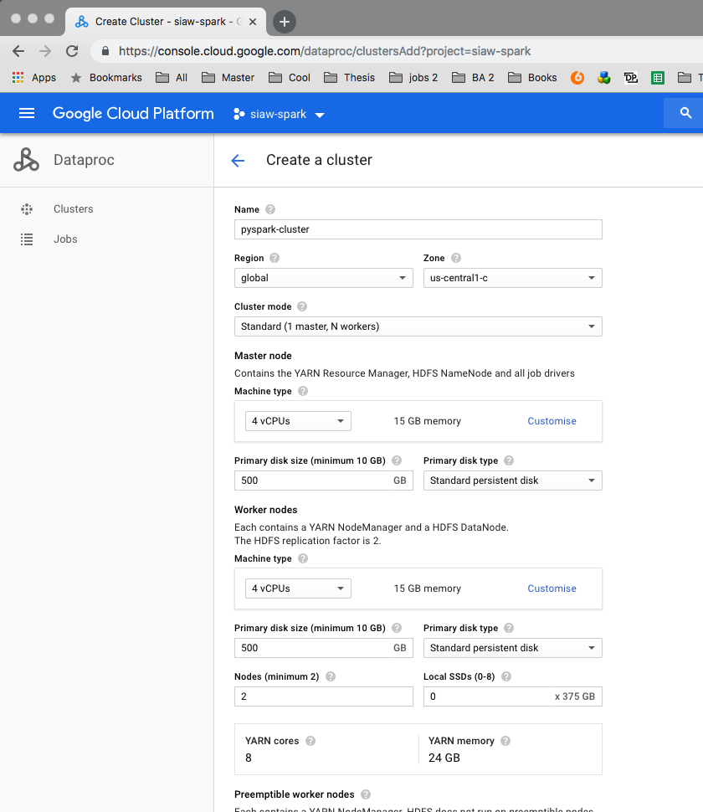
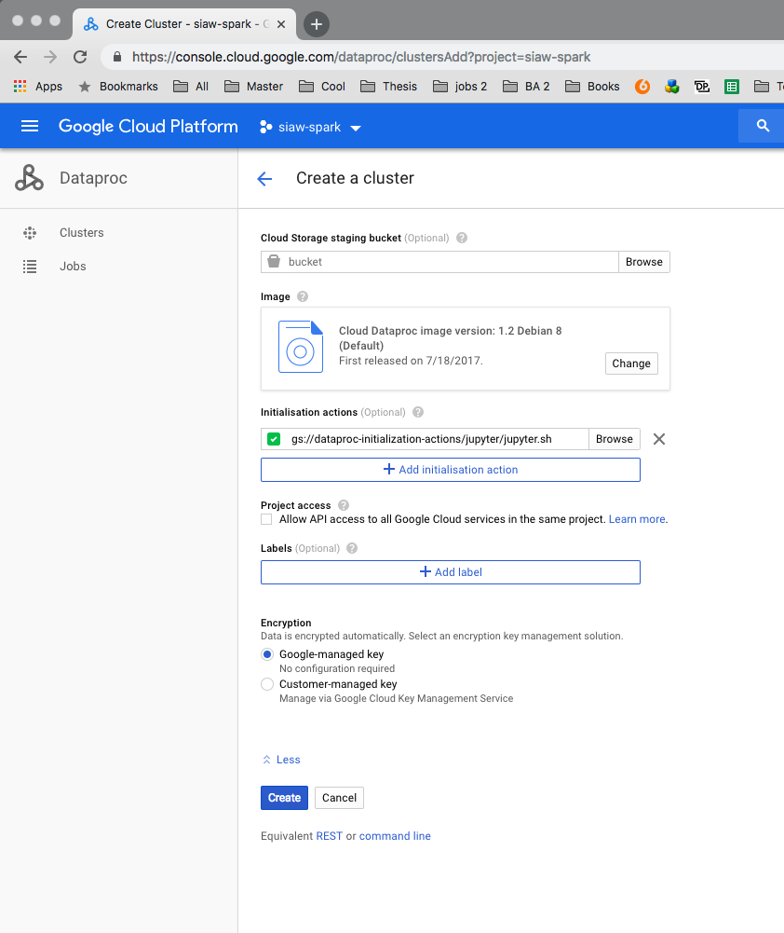
2. Cluster Creation
Assign a name to your cluster. For this installation example we will be using “pyspark-cluster”
Change the region to a location close to you, I will choose Europe West
You can change many other preferences here but for now we will ignore most of them
Open “advanced options” at the bottom and click on “add initialisation action”
Insert the link as explained on the right. The link directs to a script which allows us to use the Jupyter interface later on
Click: “create”*
Insert this link here:
gs://dataproc-initialization-actions/jupyter/jupyter.sh
* Depending on which size you choose your cluster to be, you might have to enable billing first. Enabling Billing, however, does not mean that you lose your credit. You will only be charged should you surpass your available credit
Notes:
error message

Slide 6
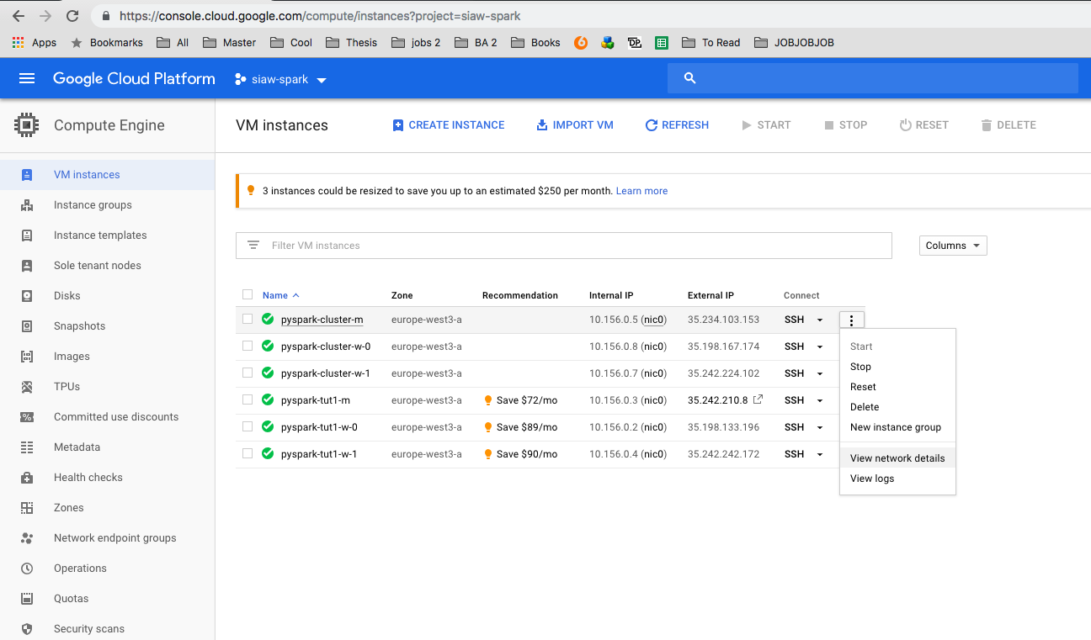
3. Setting up the Jupyter Interface
Our cluster will a few minutes to be launched. Its status will change to “Running” when ready
Click on the menu in the top left again and click on “Compute Engine”
Click on the three vertical dots to the right of your cluster with the suffix “-m” (this is the master node)
Click on “View Network Details”
Notes:
error message

Slide 7
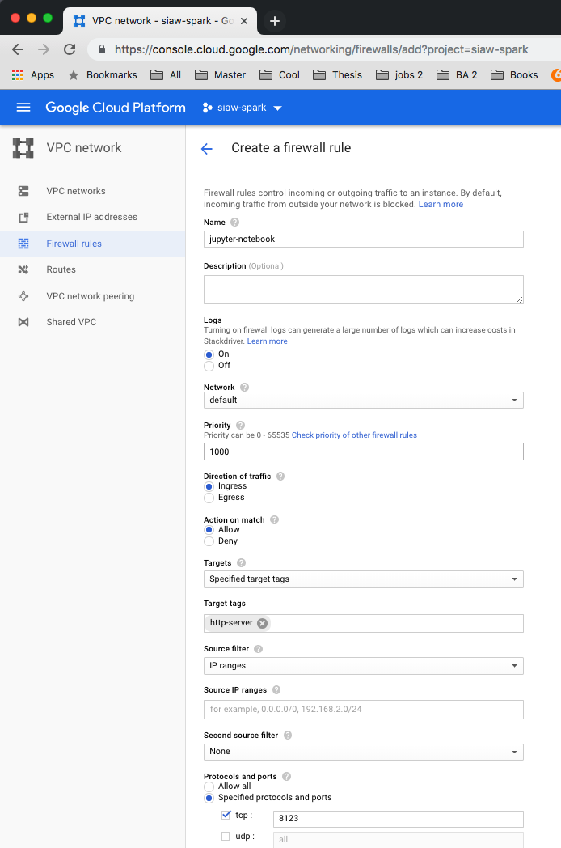
3. Setting up the Jupyter Interface
From the left, select “Firewall Rules”
Select “Create Firewall Rule”
Use the following settings: - Name: jupyter - Target tags: http-server - Source IP ranges: your v4 IP - tcp: 8123 (the script sets up Jupyter on this port)
Once created, you can use this rule for all future spark clusters
Click “Create”

Slide 8
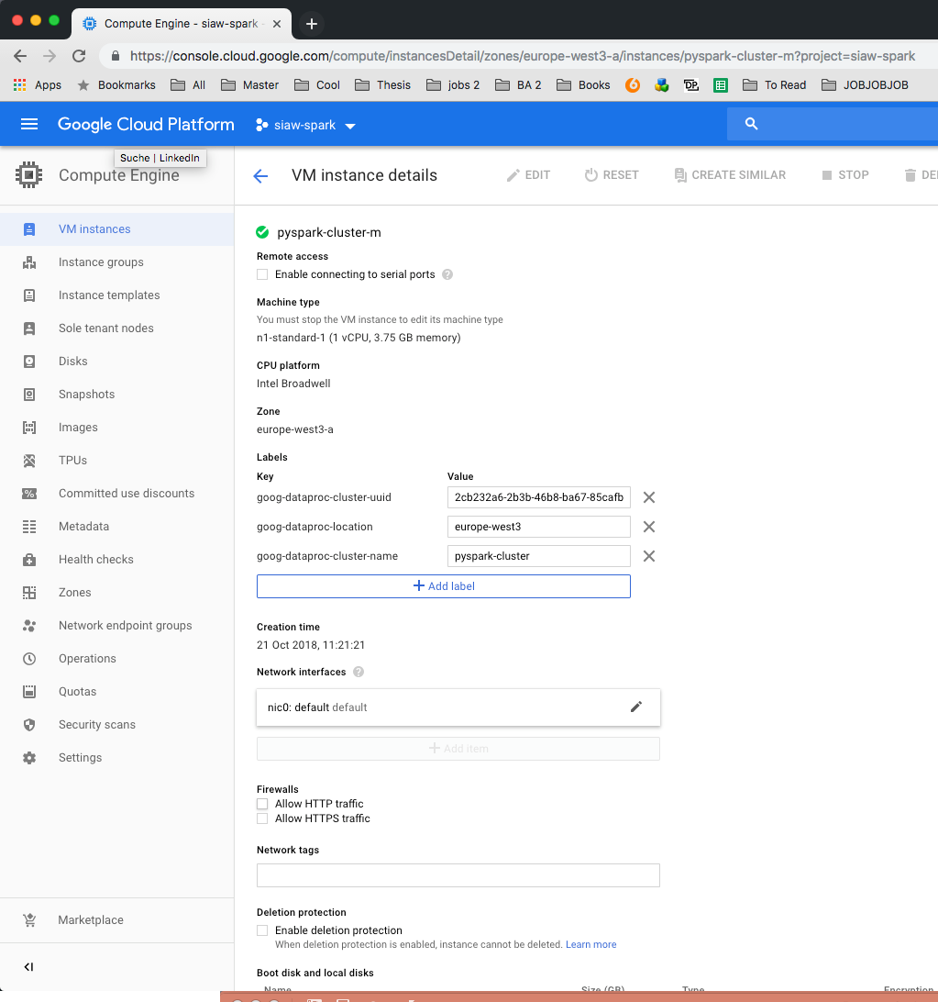
3. Setting up the Jupyter Interface
Go back to the overview of your compute engines and click on your master node
Click on edit
Tick the box stating: ”Allow HTTP traffic”
Click “save”

Slide 9
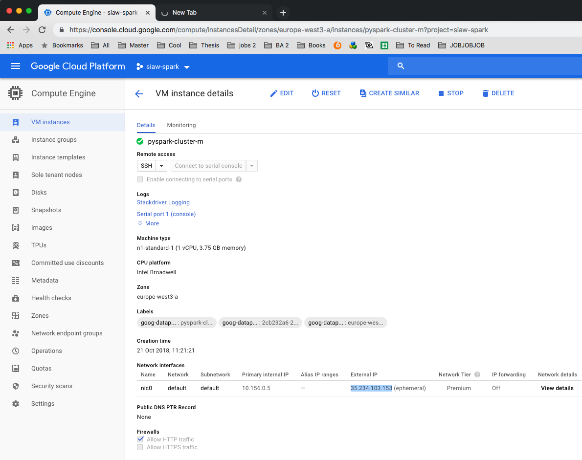
3. Setting up the Jupyter Interface
Go back to the overview of your master node and copy your master nodes IP address into your browser
add “:8123”
This is port where the jupyter notebook is available
Hit enter

Slide 10
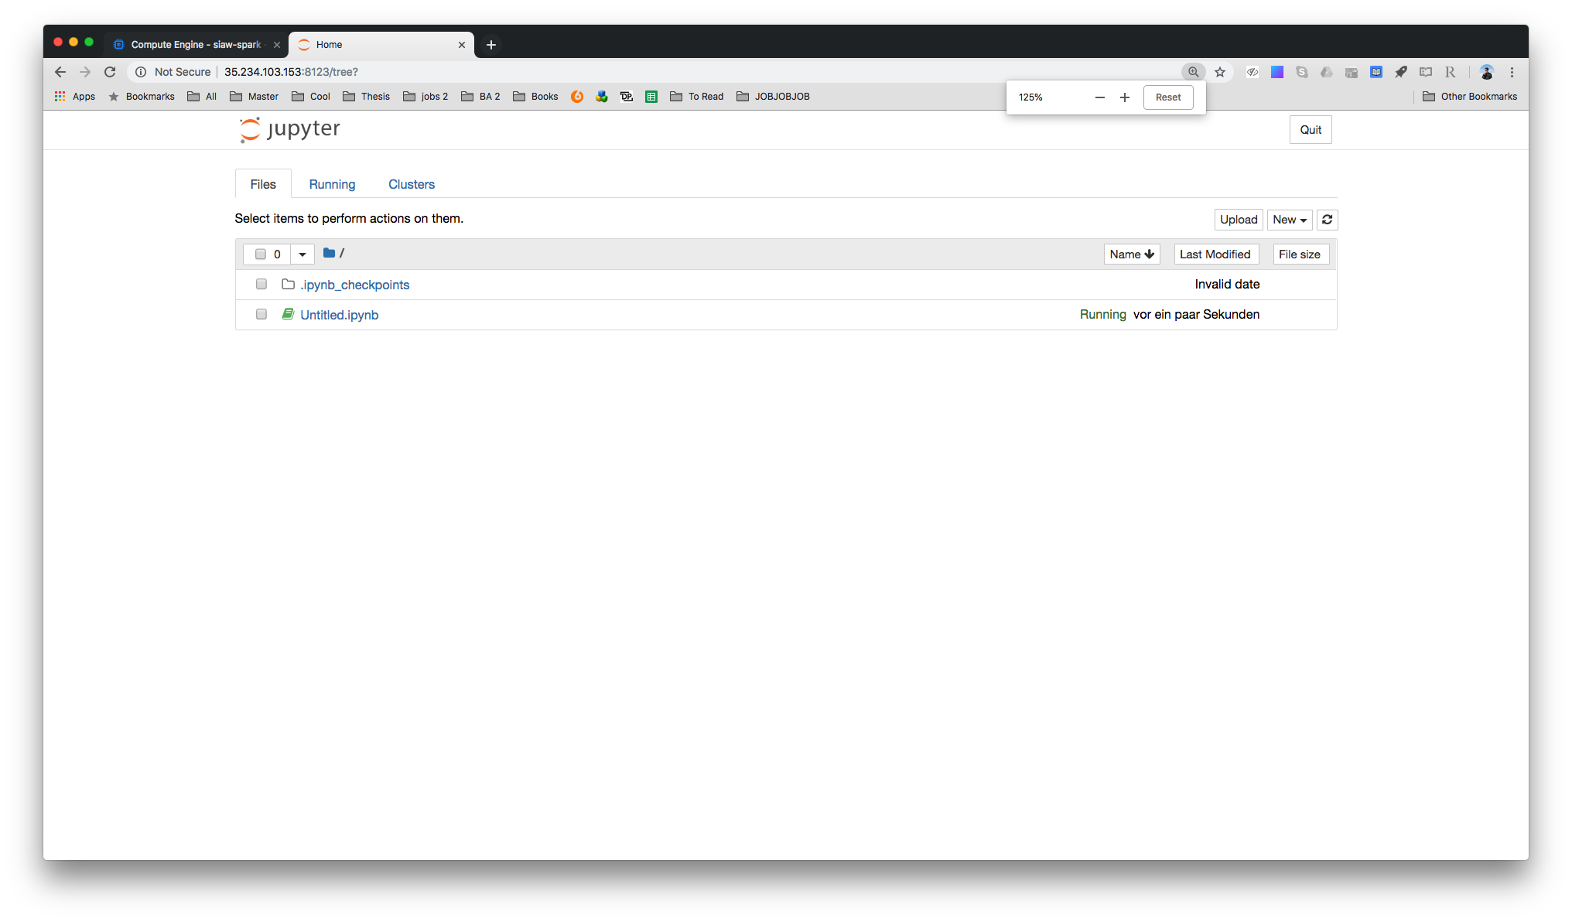
4. Done
You can now use a regular Jupyter Notebook interface for working with PySpark
Note: even though not covered specifically your your cluster comes with a storage bucket upon instantiation. You can upload data into this bucket and load it in your notebook

Slide 11
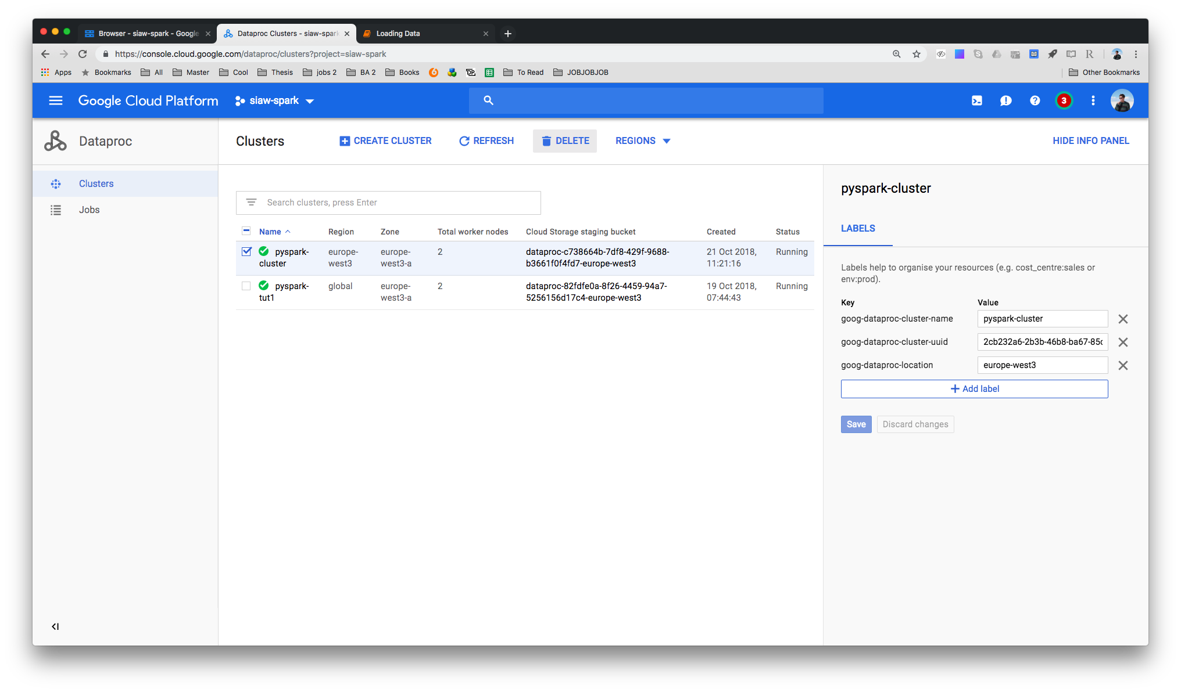
4. Deletion
Don’t remember to use your cluster when finished to avoid incurring high costs despite not using it.
Open the menu and click on the Dataproc item
Select your cluster on the left and press ”Delete” in the top menu
Confirm

Slide 12
uploading data to gcp
This section will explain how to upload data into a Google Cloud Platform storage bucket and read it from a PySpark script

Slide 13
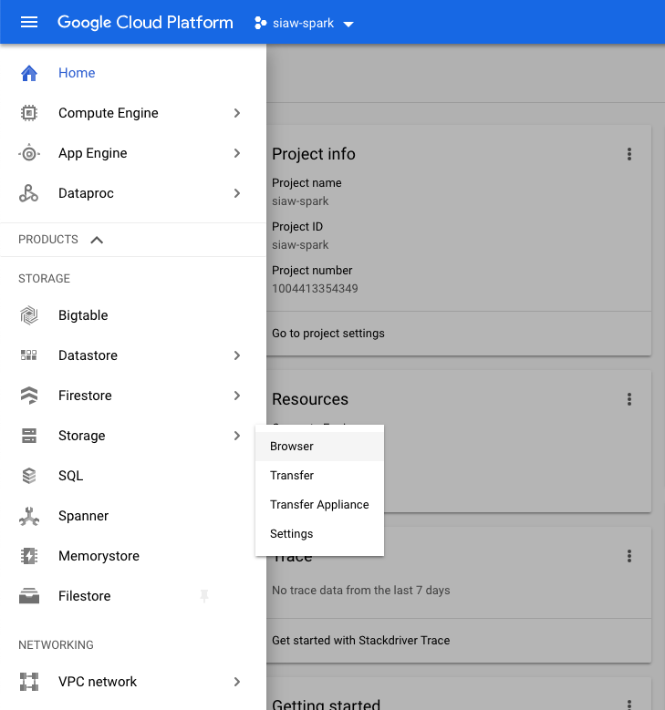
1. Uploading Data
Open your GCP console, navigate to the hamburger menu and click on “Storage”

Slide 14
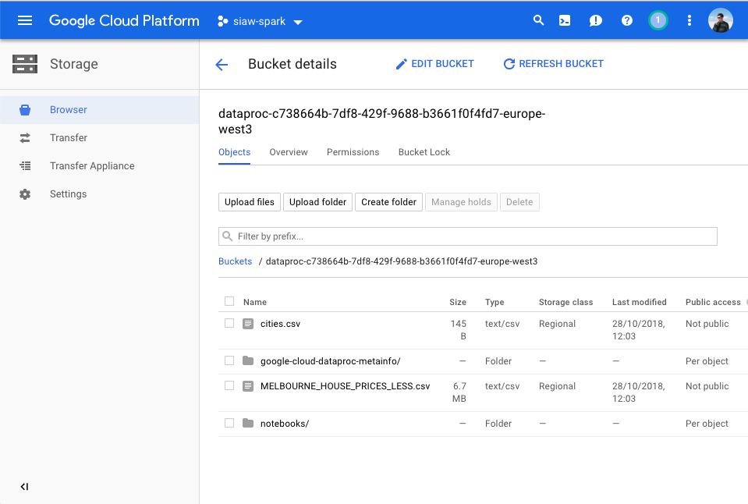
1. Uploading Data
You should be seeing a storage bucket that was automatically created when you set up your Spark Cluster. Click on it.
As of now, only metafiles and a folder for Jupyter notebooks should be living in your notebook.
Click on “Upload Files” in the top menu and select your file(s) to upload. In our case we will use a csv containing information on Avocado sales in the US

Slide 15
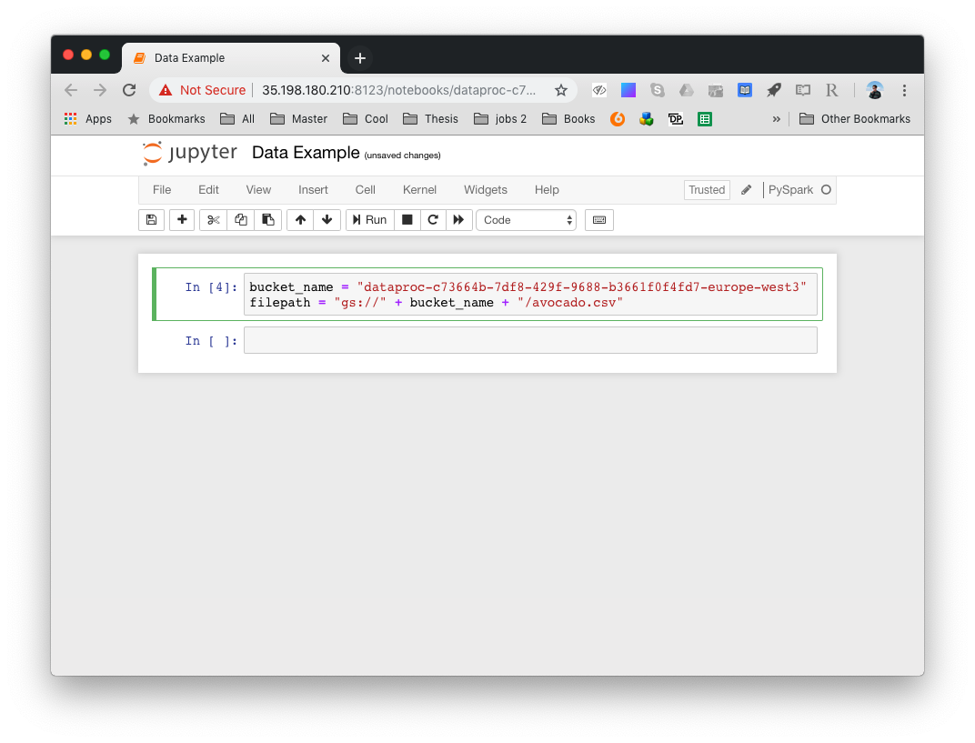
2. calling the data from a notebook
Open a new PySpark Jupyter notebook
You can access your data under the server file path which consists of the prefix ”gs://”, your server name and the path of the file in the bucket
You can copy your server name from the bucket menu in the “Uploading Data” section

Slide 16
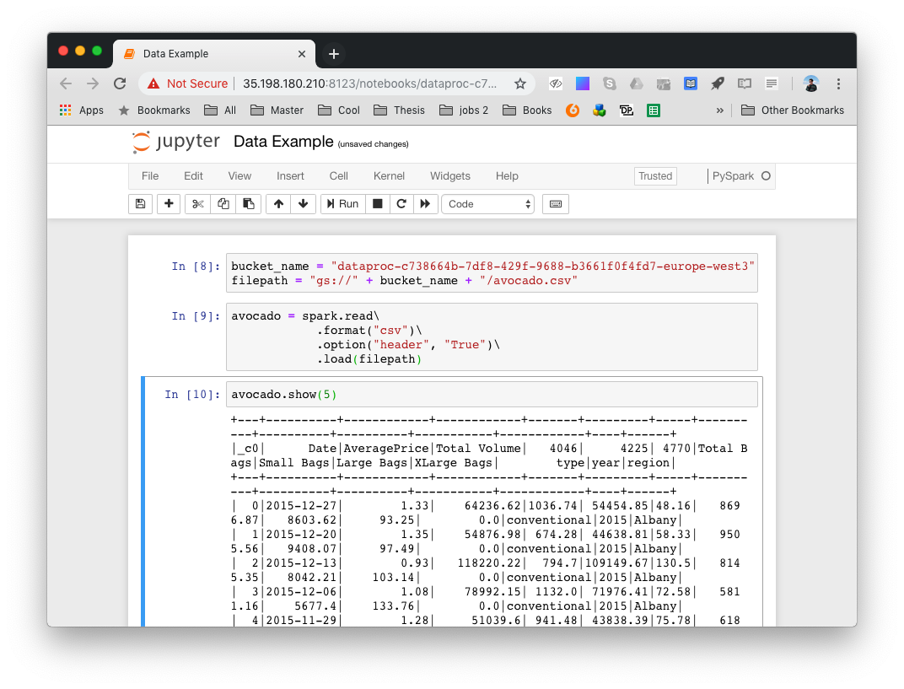
2. calling the data from a notebook
You can now access the files at the specified file path with the PySpark commands and use it as intended.

